Slide 1
Kinetic Energy and Range of Final State Particles (Update: August 28, 2023)
M. Bilal Azam, Z. Djurcic, et. al.

Slide 2
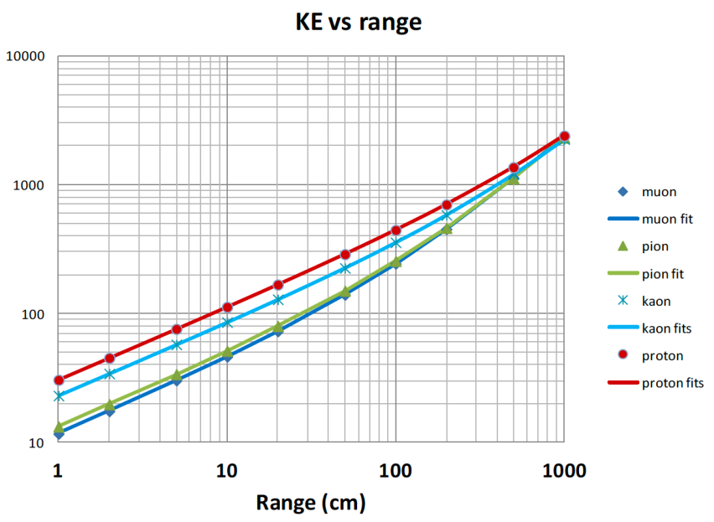
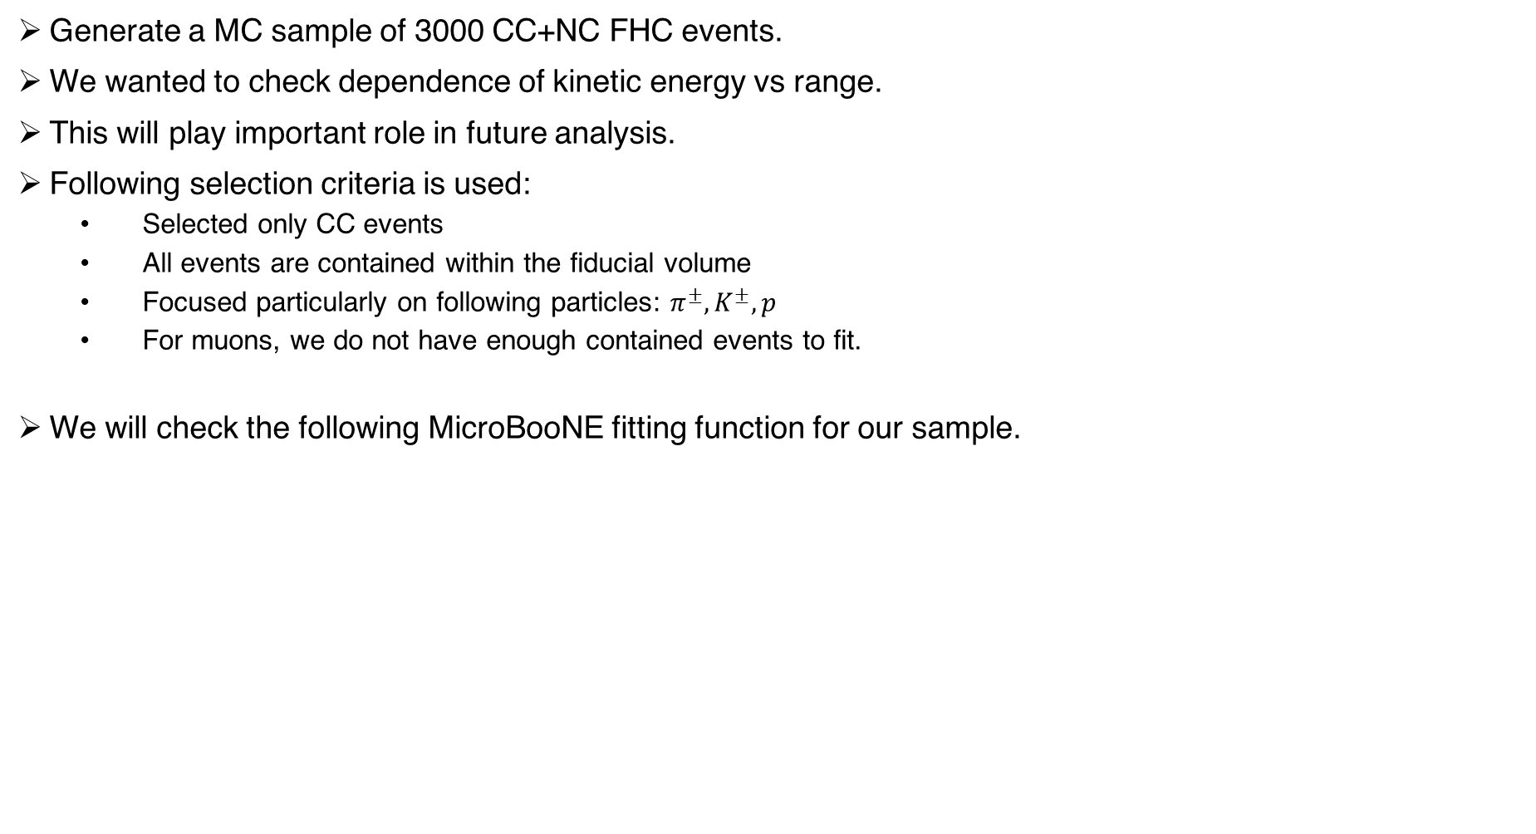

Motivation and Selection Criteria
Generate a MC sample of 3000 CC+NC FHC events.
We wanted to check dependence of kinetic energy vs range.
This will play important role in future analysis.
Following selection criteria is used:
Selected only CC events
All events are contained within the fiducial volume
Focused particularly on following particles: $π^{±},K^{±},p$
For muons, we do not have enough contained events to fit.
We will check the following MicroBooNE fitting function for our sample.
Fit Function: $T_{i}\left(R\right)=A_{i}R^{a}+B_{i}R^{b}$

Slide 3
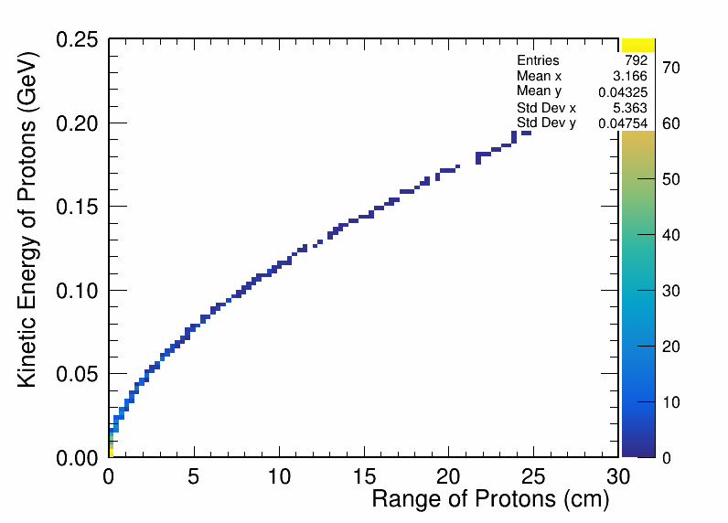
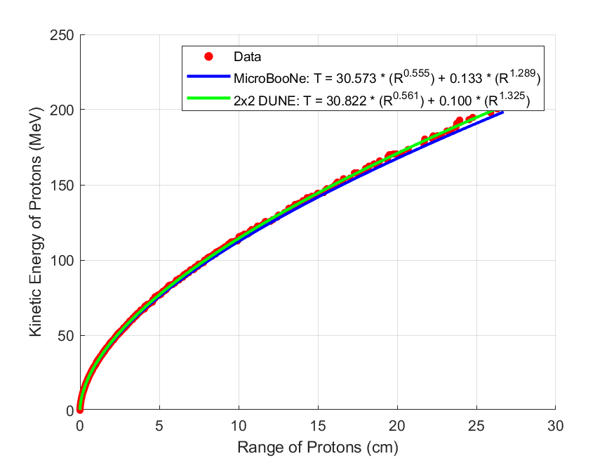

Kinetic Energy vs Range for Protons
We apply the following fit function to final state CC protons MC sample.
Fit Function: $T\left(R\right)=AR^{a}+BR^{b}$
2D histogram
Fit

Slide 4
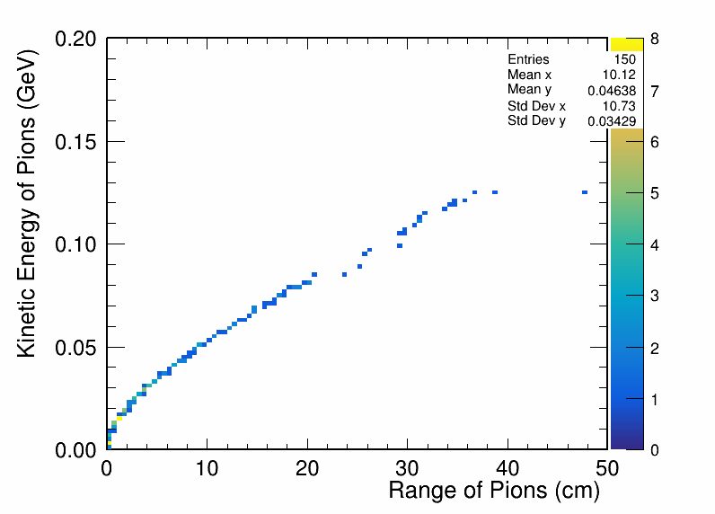
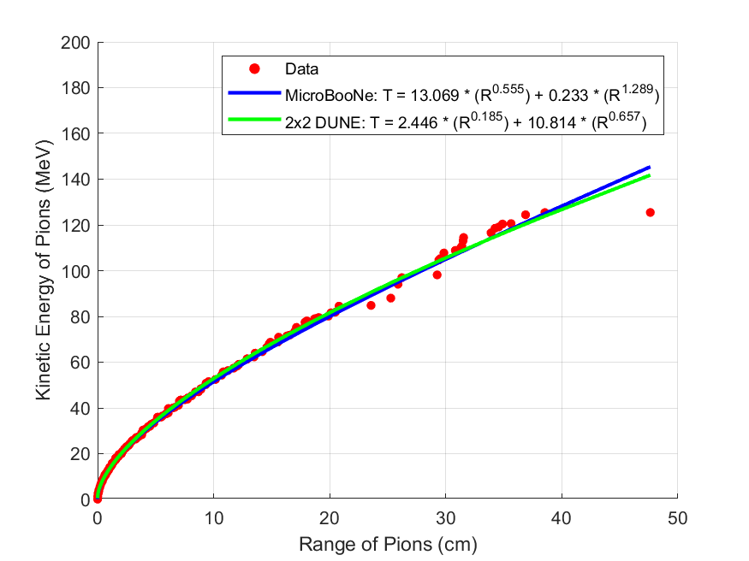
Kinetic Energy vs Range for Pions
2D histogram
Fit

Slide 5
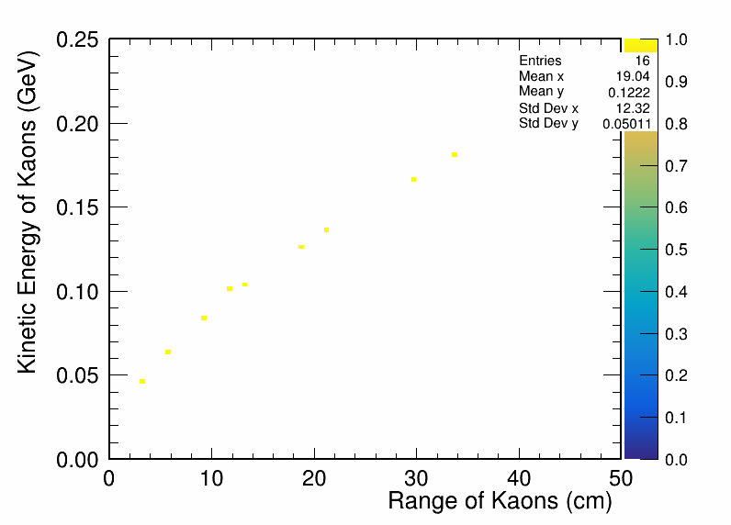
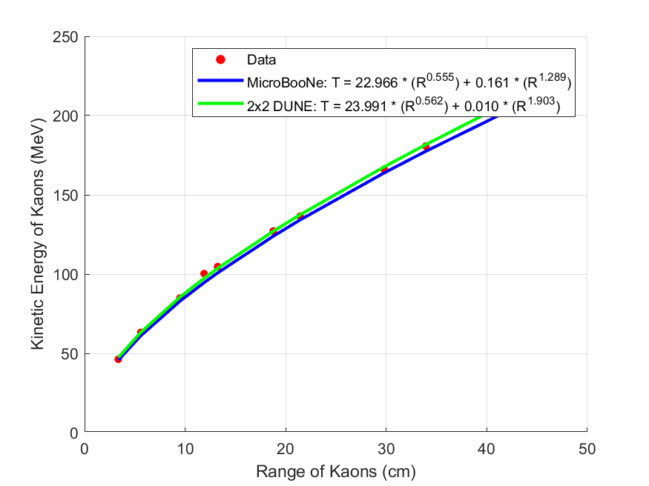
Kinetic Energy vs Range for Kaons
2D histogram
Fit

Slide 6
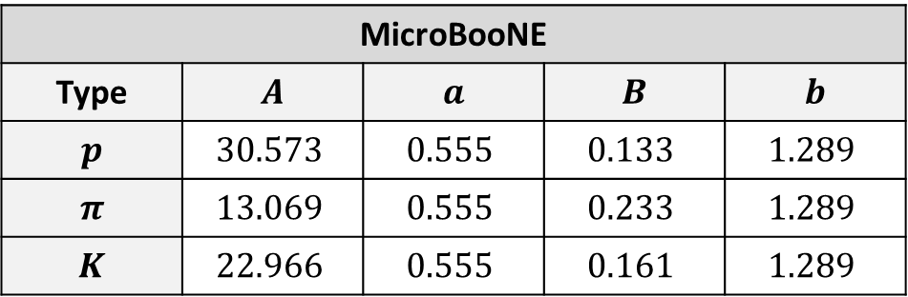
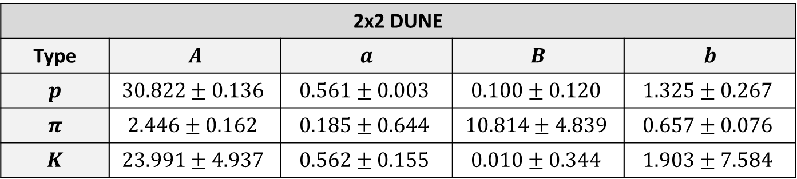
Comparison of Fit Parameters’ and Errors in 2x2 DUNE and MicroBooNE
Our fit is in good agreement with MicroBooNE fitting model.
2x2 DUNE
Type | $$A$$ | $$a$$ | $$B$$ | $$b$$
$$p$$ | $$30.822±0.136$$ | $$0.561±0.003$$ | $$0.100±0.120$$ | $$1.325±0.267$$
$$π$$ | $$2.446±0.162$$ | $$0.185±0.644$$ | $$10.814±4.839$$ | $$0.657±0.076$$
$$K$$ | $$23.991±4.937$$ | $$0.562±0.155$$ | $$0.010±0.344$$ | $$1.903±7.584$$
MicroBooNE
Type | $$A$$ | $$a$$ | $$B$$ | $$b$$
$$p$$ | $$30.573$$ | $$0.555$$ | $$0.133$$ | $$1.289$$
$$π$$ | $$13.069$$ | $$0.555$$ | $$0.233$$ | $$1.289$$
$$K$$ | $$22.966$$ | $$0.555$$ | $$0.161$$ | $$1.289$$
This study would be useful to apply energy threshold cuts on final state particles.

